Slide 1
Product Complaints
PHPR 630: Drug Information and Literature Evaluation
Spring 2019
Nathan Nguyen, PharmD

Slide 2
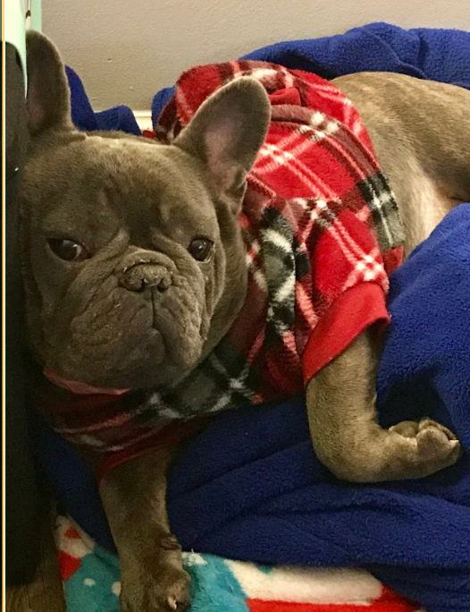

Slide 3
Objectives
Identify a product problem
Understand the purpose and importance of product problem reporting
Discuss the product problem reporting system established in the US

Slide 4
Laws and Regulations
1938 Food, Drug, and Cosmetic Act
Ensured products were safe before sold in US
Prohibited sale of adulterated or misbranded products
Adulterated Products - Impure
Misbranded Products - Inappropriate/lacking labeling
Notes:
Food Drug and Cosmetic Act was passed shortly after over 100 deaths occurred from Elixir Sulfanilamide which contained diethylene glycol, a deadly chemical used in antifreeze, to dissolve sulfanilamide. During September and October 1937 this drug was responsible for the deaths of more than 100 people in 15 states. The drug and the deaths led to the passage of the 1938 Food, Drug, and Cosmetic Act, which increased FDA's authority to regulate drugs.

Slide 5
Current Good Manufacturing Practices (cGMPs)
Establish minimum requirements for the methods, facilities, or controls used in the manufacture, processing, packaging, or holding of a pharmaceutical product
Ensure pharmaceutical products are safe and meet quality and purity requirements
Notes:
cGMP refers to the Current Good Manufacturing Practice regulations which is the main regulatory standard for ensuring pharmaceutical quality enforced by the US Food and Drug Administration (FDA). CGMPs provide for systems that assure proper design, monitoring, and control of manufacturing processes and facilities. Accordingly, the "C" in CGMP stands for "current," requiring companies to use technologies and systems that are up-to-date in order to comply with the regulations.

Slide 6
Current Good Manufacturing Practices (cGMPs)
Pharmaceutical companies must comply with GMP requirements to ensure that medicinal products are consistently produced and controlled to the quality standards appropriate to their intended use
Complaint handling is one of these GMP requirements
The manufacturer must have processes in place to identify, assess, and document complaints.
Notes:
Beyond regulatory obligations, a good complaint handling system gives the company an opportunity to improve the quality of products and demonstrate commitment to customer service.

Slide 7
Product Complaints
A report expressing dissatisfaction with the design, appearance, taste, identity, labeling, packaging, durability, safety, reliability, efficacy, or performance
Examples: product discoloration, crumbling, odor, foreign particles in the container or product, leaking vial or syringe, device malfunction, empty blister pack, wrong product, strength or quantity, missing patient information leaflet or Package Insert
Device Complaints also include misuse and performance issues
Notes:
21 CFR 211.198: Complaint Handling

Slide 8
Product Quality Problem
Product problems should be reported to the FDA when there is a concern about the quality, authenticity, performance, or safety of any medication or device
suspect counterfeit product/tampering
product contamination (chemical, insect, foreign material, microbial)
defective components (physical damage, leaks, cracks,)
poor packaging or product mix-up
questionable stability
device malfunctions
labeling concerns (confusing wording, missing label)
lack of effect

Slide 9
Information for Report
Contact information
Description of product issue
Lot/Expiration date
Product
Manufacturer may ask to retrieve product for investigation
May also ask for photo of affected product

Slide 10
Product Problem Reporting
Mandatory Reporting
pharmaceutical manufacturers, distributors, IND reporters, user facilities personnel
Voluntary Reporting
health care professionals, consumers
Utilizes the FDA MedWatch program
May call manufacturer to report product complaint
Notes:
IND - Investigational New Drug

Slide 11
Outcomes of Product Problem Reporting
Labeling changes
Improvement of packaging
Changing name of product
FDA inspection-ensuring following GMP
Product recall

Slide 12
Product Recalls
May be initiated by the FDA or manufacturer
Class I
Dangerous or defective products that predictably could cause serious health problems or death
Class II
Products that might cause a temporary health problem, or pose only a slight threat of a serious nature
Class III
Products that are unlikely to cause any adverse health reaction, but violates FDA labeling or manufacturing laws
http://www.fda.gov/Safety/Recalls/default.htm
Notes:
Class I recall is an urgent matter. It may involve wrong product (label and contents are different products),chemical contamination/microbial contamination of injectable and sterile ophthalmologic product. An example is when in 2014 Baxter mislabeled potassium chloride injection 10 mEQ/100 mL as a more concentrated 20 mEq/100 mL Class II recalls:
mislabelling (for example, wrong or missing text or figures), missing or incorrect safety information in leaflets or inserts
microbial contamination of non-injectable, non-ophthalmic sterile product with medical consequences
mix-up of products in containers, non-compliance with specification, such as in an assay, stability, fill or weight resulting in medical consequences. An example is delivery issues with certain lots of GSK’s Ventolin HFA Inhaler
A Class III recall is a non-safety related recall. The product meets acceptable standards of safety and efficacy and the issue does not in itself present an imminent risk. However, if not rectified, the situation may present a hazard in the future. Examples include: faulty packaging, such as wrong or missing batch number or expiration date,
faulty closure . An example of a Class III recall is with the BCP Lutera which contained an outdated package insert.

Slide 13
Question
Which of the following is NOT a Product Complaint?
Consumer states that her medication is not working
There are visible particles in a vial of Cytarabine Inj.
Pharmacist found a broken tablet in a new 100 ct bottle
Consumer complains that her EPIPEN is too expensive

Slide 14
Question
Which of the following is NOT a Product Complaint?
Consumer states that her medication is not working
There are visible particles in a vial of Cytarabine Inj.
Pharmacist found a broken tablet in a new 100 ct bottle
Consumer complains that her EPIPEN is too expensive

Slide 15
Question
By US law, what is NOT required to be documented in the complaint file?
Reporter’s name and contact information
Whether reporter wants refund or replacement
Lot and Expiration Date
Complaint description

Slide 16
Question
By US law, what is NOT required to be documented in the complaint file?
Reporter’s name and contact information
Whether reporter wants refund or replacement
Lot and Expiration Date
Complaint description

Slide 17
Question
A caregiver has been reported of crushing Astagraf XL and administering it to the patient. What report(s) need to be completed?
Adverse Event
Product Complaint
All of the Above
None of the Above

Slide 18
Question
A caregiver has been reported of crushing Astagraf XL and administering it to the patient. What report(s) need to be completed?
Adverse Event
Product Complaint
All of the Above
None of the Above

Slide 19
References
CURRENT GOOD MANUFACTURING PRACTICE FOR FINISHED PHARMACEUTICALS, 21 C.F.R. § 211 (2018).
Food and Drug Administration: Facts About the Current Good Manufacturing Practices (CGMPs). https://www.fda.gov/drugs/developmentapprovalprocess/manufacturing/ucm169105.htm. Accessed April 10, 2019.
Food and Drug Administration: FDA 101: Product Recalls. http://www.fda.gov/ForConsumers/ConsumerUpdates/ucm049070.htm. Accessed April 10, 2019.
Food and Drug Administration: Product Problems. http://www.fda.gov/safety/medwatch/howtoreport/ucm053091.htm. Accessed April 10, 2019.
Food and Drug Administration: Report a Problem. http://www.fda.gov/Safety/ReportaProblem/default.htm. Accessed April 10, 2019.
Food and Drug Administration: The 1938 Food, Drug, and Cosmetic Act. https://www.fda.gov/AboutFDA/History/ProductRegulation/ucm132818.htm. Accessed April 10, 2019.

